Slide 1

Exploratory Data Analysis
<G2M-insight-for-Cab-Investment>
<2022-07-14>

Slide 2

Introduction
XYZ is a private firm in US. Due to remarkable growth in the Cab Industry in last few years and multiple key players in the market, it is planning for an investment in Cab industry and as per their Go-to-Market(G2M) strategy they want to understand the market before taking final decision.

Slide 3
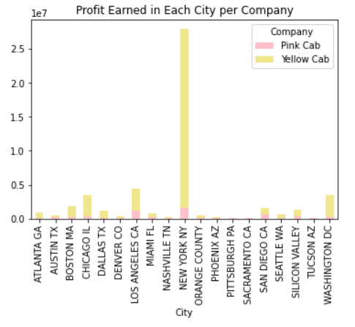
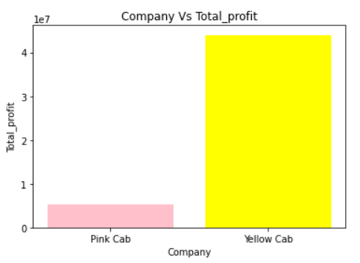
Profit earned by both company

Slide 4
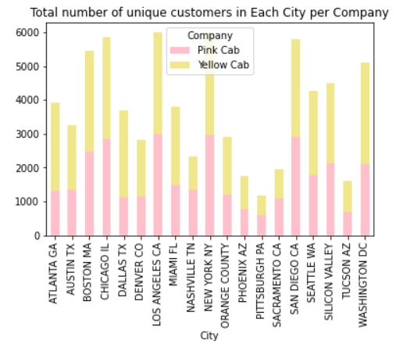
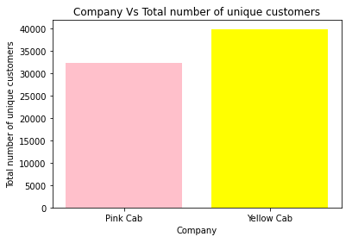
Which company is more favored by the customers?

Slide 5
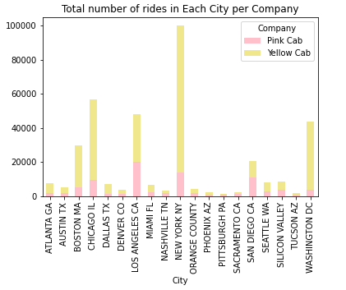
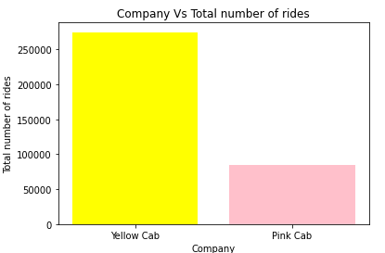
WHICH COMPANY HAS A LARGER NUMBER OF TRIPS?

Slide 6
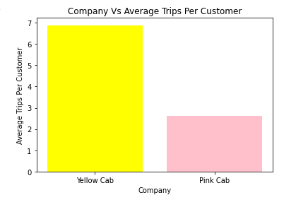
Does Yellow Cab has a higher average trips per customer ?

Slide 7
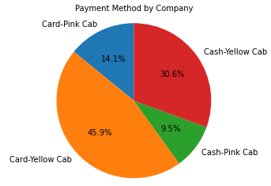
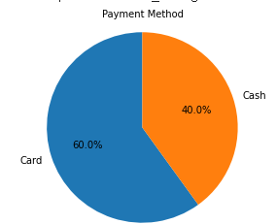
Which payment method do customers prefer?

Slide 8
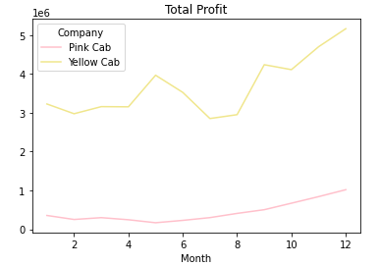
How profit changed over the period?

Slide 9
Analysis
1. Yellow Company has a higher profit than Pink Company.
2. Yellow Company and Pink Company have huge amount of customers but the number of rides and the average number of rides per customer of Yellow Company is larger than Pink Company.
Hence, the Yellow Company is a more competitive company to invest.
.

